Slide 1
🔒
Brute Force Attack
Simulation & Secure Account Lockout Mechanism
Information Security | Python Implementation | 2026

Slide 2
What is a Brute Force Attack?
An attacker tries every possible password one by one until the correct one is found — like trying every key on a keyring until the door opens.
Pick a target
Try passwords
Crack found!
Attacker knows the username
Loop through common passwords
Correct password discovered
Without protection, this happens in milliseconds

Slide 3


Phase 1 — Vulnerable System
✗ NO LOGIN ATTEMPT LIMIT ✗ NO ACCOUNT LOCKOUT ✗ NO DELAY
def vulnerable_login(username, password):
if
username in users and users[username] == password:
return True
return False
Result
Password cracked in 0.00 seconds
16,000 attempts/sec No protection at all
[1] Trying: '123456' → wrong
[2] Trying: 'password' → wrong
[7] Trying: 'sunshine99' → CRACKED! *** Password found in 0.00s ***

Slide 4
Phase 2 — Secure Account Lockout Mechanism
Attempt Limit
Account Lockout
Progressive Delay
Max 3 wrong tries before lockout triggers
Account frozen for 10 seconds
+1 second added per wrong attempt
Result
[1] Trying: '123456' → wrong (1/3)
[2] Trying: 'password' → wait 1s → wrong (2/3)
[3] Trying: 'hello' → wait 2s → ACCOUNT LOCKED
[4] Trying: 'qwerty' → BLOCKED! 10s remaining
[7] Trying: 'sunshine99' → BLOCKED! Still locked
Attack BLOCKED
Only 3 real attempts before lockout
Password never found

Slide 5
Vulnerable vs Secured — Comparison
Metric
✗ Vulnerable
✓ Secured
Password Cracked?
YES
NO
Real Attempts Made
16 attempts
3 attempts
Time Elapsed
0.00 seconds
3.00 seconds
Attempts Per Second
16,000/sec
0.8/sec
Attempt Limit
None
Max 3
Account Lockout
None
10 seconds
Progressive Delay
None
+1s per fail

Slide 6
How the Code Works
users { }
wordlist [ ]
attack( )
is_locked( )
Dictionary storing usernames & passwords
List of passwords the attacker tries
Loops through wordlist and tries each password
Checks if account is currently frozen
apply_delay( )
record_failure( )
Waits longer after each wrong attempt
Counts wrong tries and triggers lockout
All parts combined in one file → Project_Code.py
Run with: python Project_Code.py

Slide 7
Conclusion
⚡ Unlimited login attempts allow attackers to crack passwords in milliseconds
🔢 An attempt limit of just 3 stops the attack before the password is reached
🔒 Account lockout freezes the account completely — even the correct password is rejected
🐢 Progressive delay slows each attempt down, making automation impractical
🛡 Combining all three defenses makes brute force attacks practically impossible

Slide 8
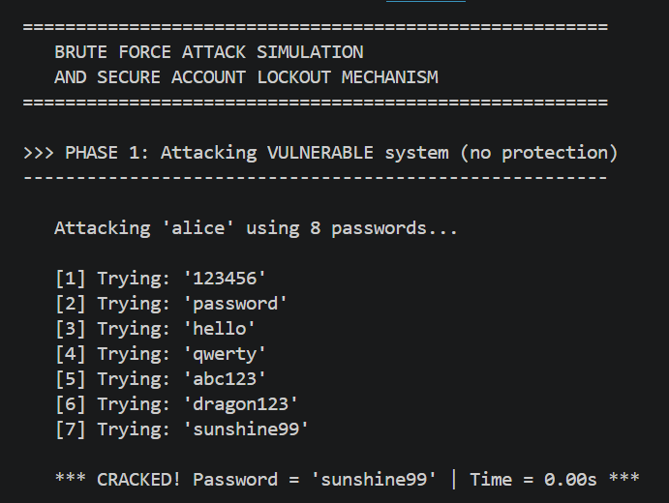
Brute Force Attack Demo on terminal

Slide 9
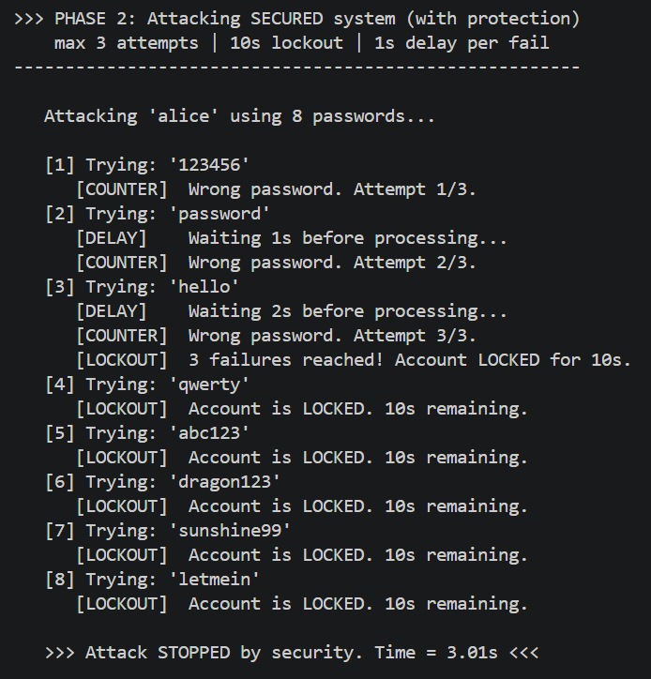
Attack with protection on terminal

Slide 10
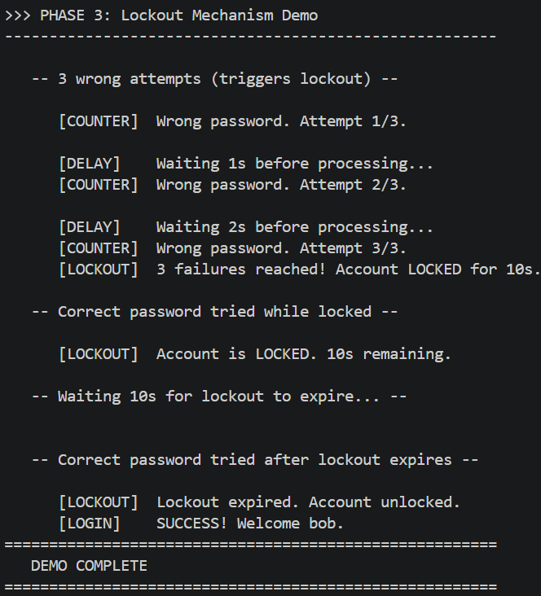
Lockout Mechanism Demo on Terminal

